Slide 1
Lecture: Binary Tree Implementation in Java
Array representation, array-to-tree conversion, traversal, level, height, and size
CSE220 | Binary Tree Java Lecture

Slide 2
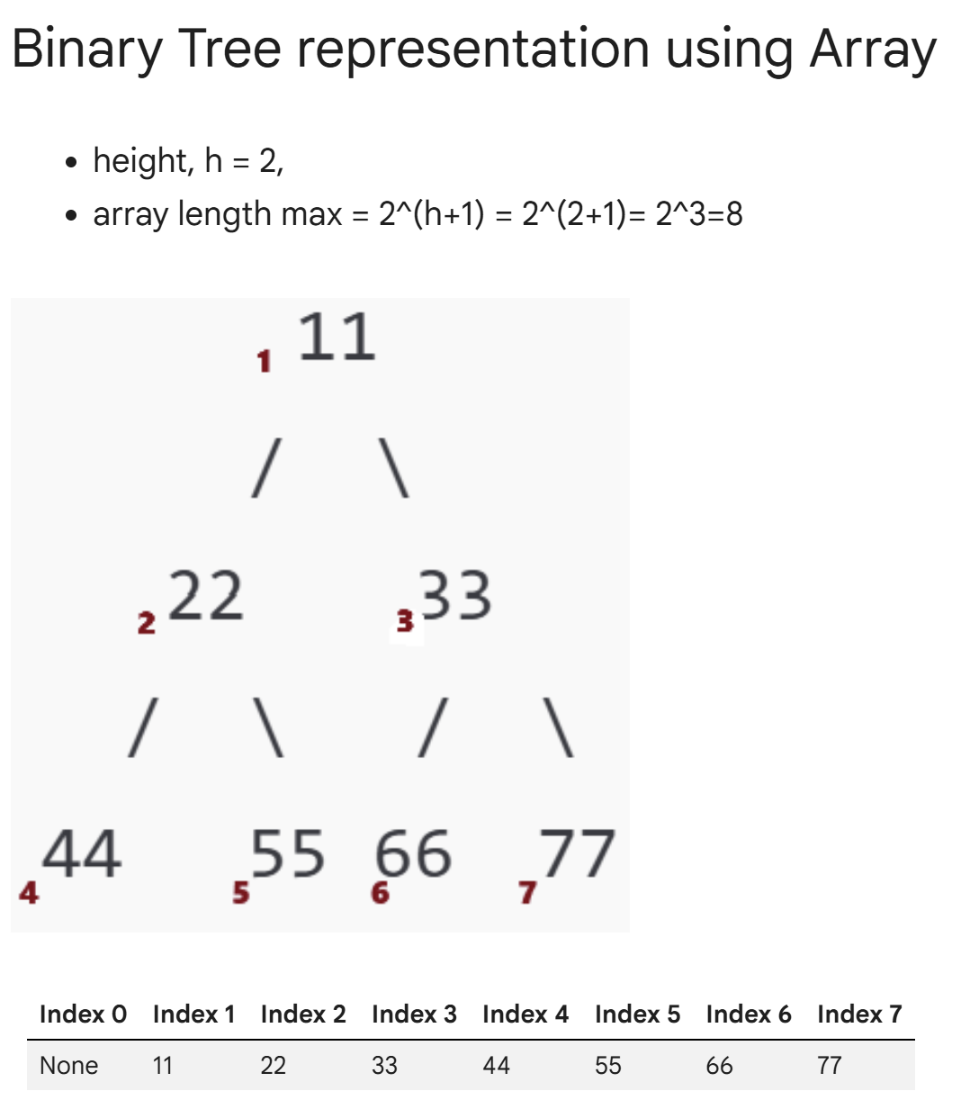
Binary Tree Representation Using Array
Key rules:
• Root is stored at index 1. Index 0 is unused.
• For node at index i: left child = 2i, right child = 2i + 1.
• For height h, maximum array length = 2^(h+1).
class Tree {
Object[] tree;
public Tree(Object root, int length) {
// 1-based indexing: index 0 unused
tree = new Object[length];
tree[1] = root;
}
public void setChild(int parentIndex, String side,
Object child) {
int childIndex;
if (side.equals("left")) {
childIndex = parentIndex * 2;
} else {
childIndex = parentIndex * 2 + 1;
}
tree[childIndex] = child;
}
}

Slide 3
Array Representation: Driver Code Example
# Driver Code
tree = Tree(root=11, length=8)
# Length is 8 to accommodate up to 7 nodes
"""
11
/ \
22 33
/ \ / \
44 55 66 77
"""
# Set children for each node
tree.set_child(parent_index=1, side='left', child_val=22)
tree.set_child(parent_index=1, side='right', child_val=33)
tree.set_child(parent_index=2, side='left', child_val=44)
tree.set_child(parent_index=2, side='right', child_val=55)
tree.set_child(parent_index=3, side='left', child_val=66)
tree.set_child(parent_index=3, side='right', child_val=77)
# Print the tree structure with indices
tree.print_tree_array()
class Tree {
Object[] tree;
public Tree(Object root, int length) {
// 1-based indexing: index 0 unused
tree = new Object[length];
tree[1] = root;
}
public void setChild(int parentIndex,
String side,
Object child) {
int childIndex;
if (side.equals("left")) {
childIndex = parentIndex * 2;
} else {
childIndex = parentIndex * 2 + 1;
}
tree[childIndex] = child;
}
}

Slide 4
Printing the Array Representation
The array stores tree nodes level by level.
Null or empty positions can be printed as "-" to show missing children clearly.
public void printTreeArray() {
for (int i = 0; i < tree.length; i++) {
if (tree[i] != null) {
System.out.print(tree[i] + " ");
} else {
System.out.print("- ");
}
}
System.out.println();
}
// Output for the example:
// - 11 22 33 44 55 66 77

Slide 5
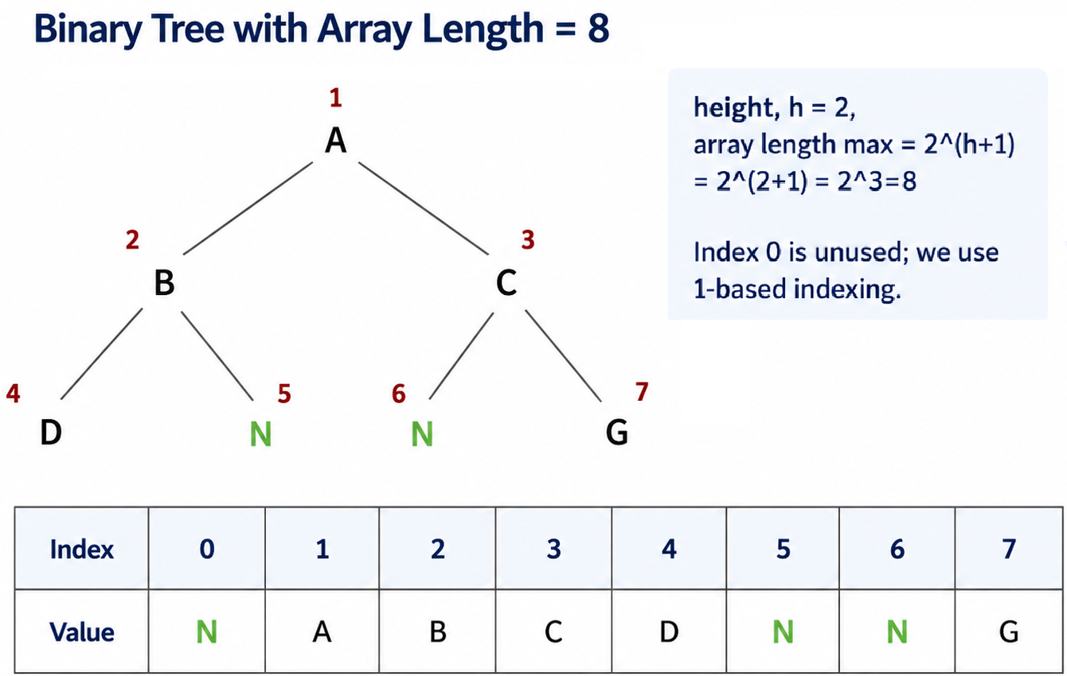
class TNode {
String val;
TNode left, right;
TNode(String val) {
this.val = val;
}
}
Recursive Function: arrToTree()
Purpose: convert the array representation into linked nodes.
Each recursive call creates one node and then builds its left and right subtrees.
public static TNode arrToTree(String[] arr, int i) {
// Base Case: Check if index is out of bounds or
the current element is None
if (i >= arr.length || arr[i] == null) {
return null;
}
// Recursive Case:
// 1. Create a node for the current index
TNode root = new TNode(arr[i]);
// 2. Set the left child by
recursively calling for index 2 * i
root.left = arrToTree(arr, 2 * i);
// 3. Set the right child by
recursively calling for index 2 * i + 1
root.right = arrToTree(arr, 2 * i + 1);
return root;
}
# Driver part # arrToTree(arr, 1)
CSE220 | Binary Tree

Slide 6
Recursive Function: arrToTree() (Show simulation)
public static TNode arrToTree(String[] arr, int i) {
// Base Case: Check if index is out of bounds or
the current element is None
if (i >= arr.length || arr[i] == null) {
return null;
}
// Recursive Case:
// 1. Create a node for the current index
TNode root = new TNode(arr[i]);
// 2. Set the left child by
recursively calling for index 2 * i
root.left = arrToTree(arr, 2 * i);
// 3. Set the right child by
recursively calling for index 2 * i + 1
root.right = arrToTree(arr, 2 * i + 1);
return root;
}
# Driver part # arrToTree(arr, 1)
CSE220 | Binary Tree

Slide 7
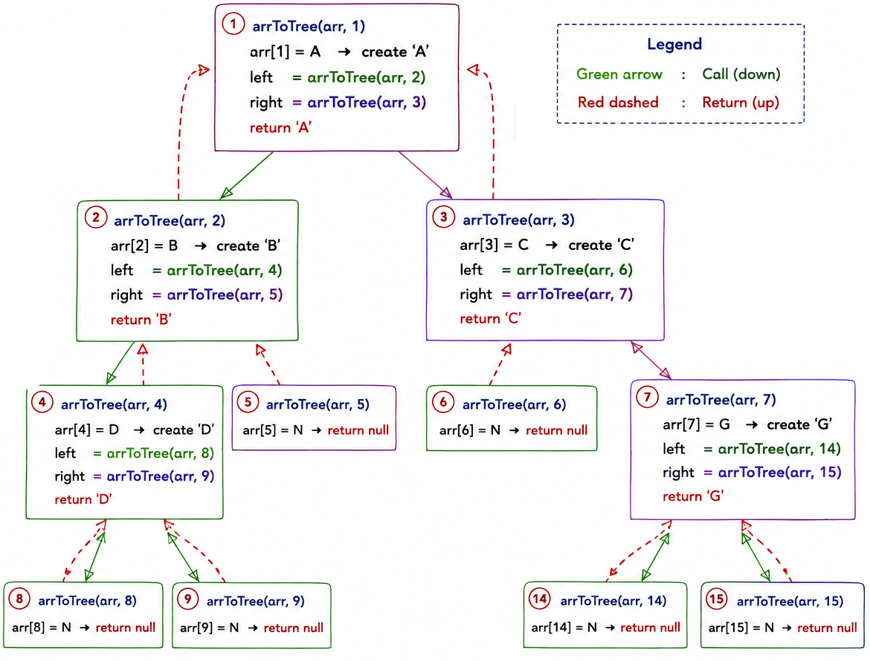
Recursive Function: arrToTree() (Show simulation)
public static TNode arrToTree(String[] arr, int i) {
// Base Case: Check if index is out of bounds or
the current element is None
if (i >= arr.length || arr[i] == null) {
return null;
}
// Recursive Case:
// 1. Create a node for the current index
TNode root = new TNode(arr[i]);
// 2. Set the left child by
recursively calling for index 2 * i
root.left = arrToTree(arr, 2 * i);
// 3. Set the right child by
recursively calling for index 2 * i + 1
root.right = arrToTree(arr, 2 * i + 1);
return root;
}
# Driver part # arrToTree(arr, 1)
CSE220 | Binary Tree

Slide 8
Binary Tree Traversal: Preorder, Inorder, Postorder
Traversal means visiting all nodes in a specific order. The position of the root determines the traversal type.
public static void printPreOrder(TNode root) {
// Base case
if (root == null)
return;
// Recursive case
System.out.print(root.val + " "); // Root
printPreOrder(root.left); // Left
printPreOrder(root.right); // Right
}
1
public static void printInOrder(TNode root) {
// Base case
if (root == null) return;
// Recursive case
printInOrder(root.left); // Left
System.out.print(root.val + " "); // Root
printInOrder(root.right); // Right
}
}
CSE220 | Binary Tree

Slide 9
Binary Tree Traversal: Preorder, Inorder, Postorder
Traversal means visiting all nodes in a specific order. The position of the root determines the traversal type.
public static void printPostOrder(TNode root) {
// Base case
if (root == null) return;
// Recursive case
printPostOrder(root.left); // Left
printPostOrder(root.right); // Right
System.out.print(root.val + " "); // Root
}
CSE220 | Binary Tree

Slide 10
Get Level of a Node
public static int getLevel(TNode root, String value, int level){
// Base case: value not found
if (root == null) {
return -1;
}
// If the current node matches the value, return the current level
if (root.val.equals(value)) {
return level;
}
// Recursive case: Search in the left subtree
int leftLevel = getLevel(root.left, value, level + 1);
// Recursive case: Search in the right subtree
int rightLevel = getLevel(root.right, value,level + 1);
// If value was not found in either subtree, return -1
// Leaf node--one which has left and right node to be None
if left_level == -1 and right_level == -1:
return -1
// Return the level where the value was found,
//either in the left or right subtree (whichever is not -1)
//--because -1 means not found in that sub tree
return Math.max(leftLevel, rightLevel);
}
Level 0
A
Level 1
B
C
Level 2
D
E
Level = number of edges from the root to the node.
Start with level 0 at the root and
increase by 1 in each recursive call.
Example:
level(E) = 2,
level(C) = 1,
level(P) = -1 (value not found).
CSE220 | Binary Tree

Slide 11
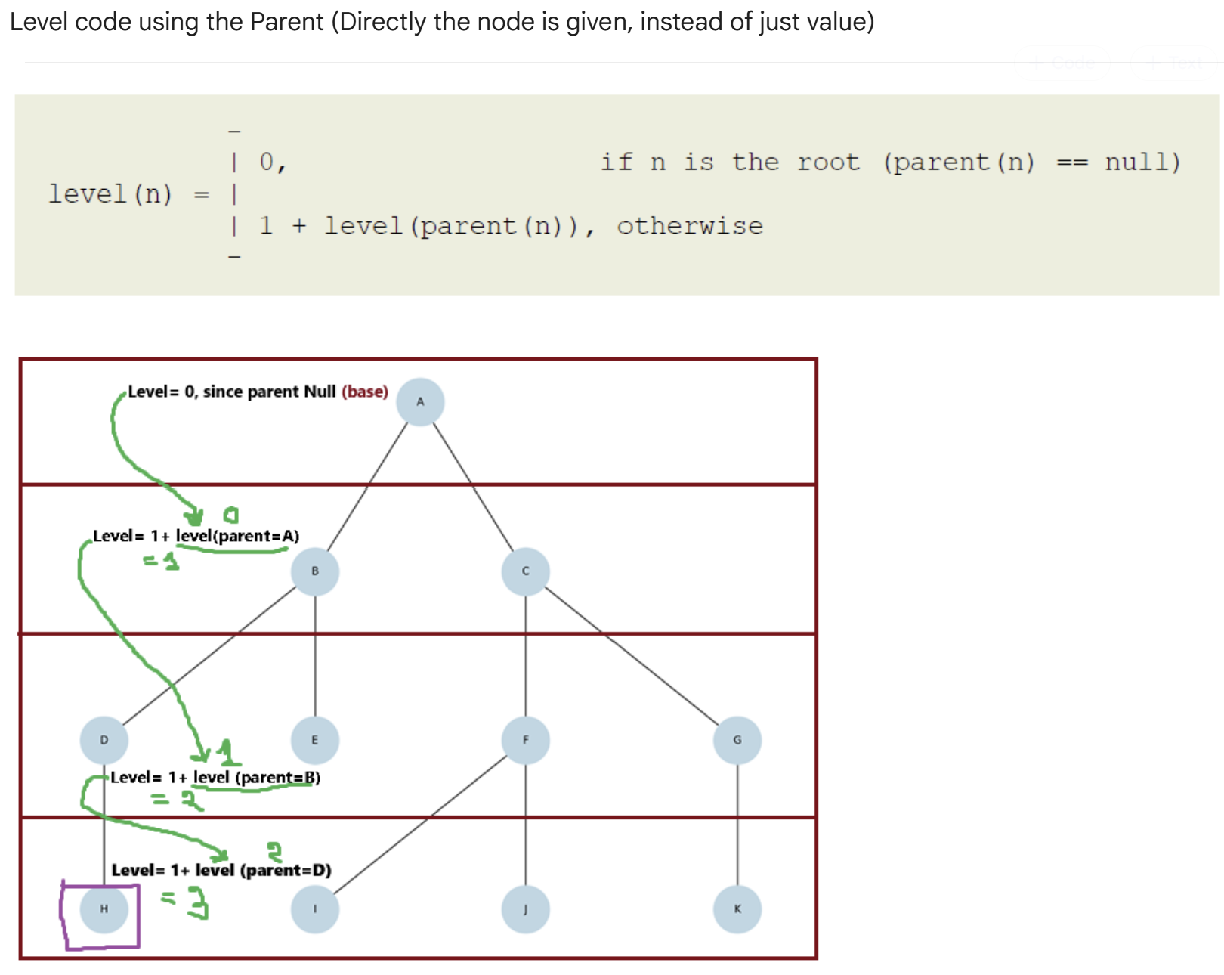
Finding the Node Before Computing Level with parent
First search the node by value. If found, compute the level by moving through parent pointers.
public static TPNode findNode(TPNode root, String target) {
""" if node found will return the node, otherwise None"""
// Base case: target not found
if (root == null) return null;
// Base case: Target found
if (root.val.equals(target)) return root;
// Search in the left subtree
TPNode left = findNode(root.left, target);
if (left != null) return left;
// If not found in left subtree, search in the right subtree
return findNode(root.right, target);
}
Level 0
A
Level 1
B
C
Level 2
D
E
CSE220 | Binary Tree

Slide 12
Finding the Node Before Computing Level with parent
First search the node by value. If found, compute the level by moving through parent pointers.
public static int getLevelWithParent(TPNode node) {
// Base case: Target not found
if (node == null) return -1;
// Base case: Root node has level 0
if (node.parent == null) return 0;
// Recursive case
return 1 + getLevelWithParent(node.parent);
}
// Use together:
// TPNode node = findNode(root, "D");
// int level = getLevelWithParent(node);
Level 0
A
Level 1
B
C
Level 2
D
E
CSE220 | Binary Tree

Slide 13
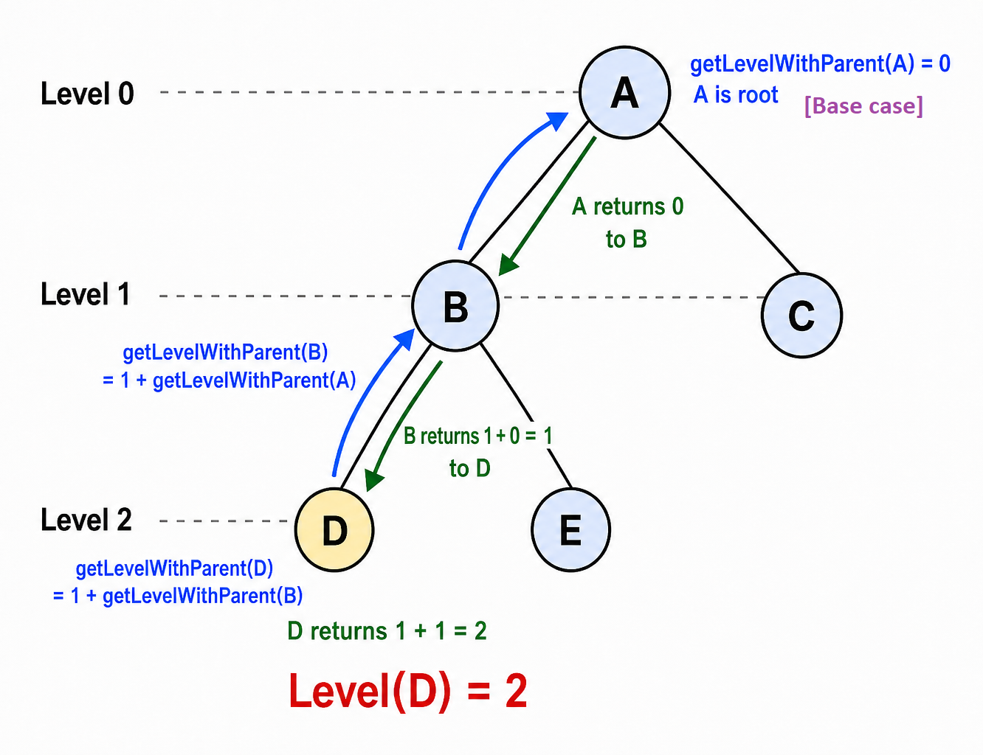
Finding the Node Before Computing Level with parent
public static int getLevelWithParent(TPNode node) {
// Base case: Target not found
if (node == null) return -1;
// Base case: Root node has level 0
if (node.parent == null) return 0;
// Recursive case
return 1 + getLevelWithParent(node.parent);
}
// Use together:
// TPNode node = findNode(root, "D");
// int level = getLevelWithParent(node);

Slide 14
Finding the Node Before Computing Level with parent

Slide 15
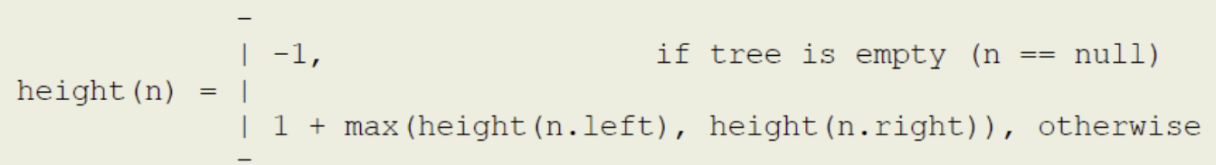
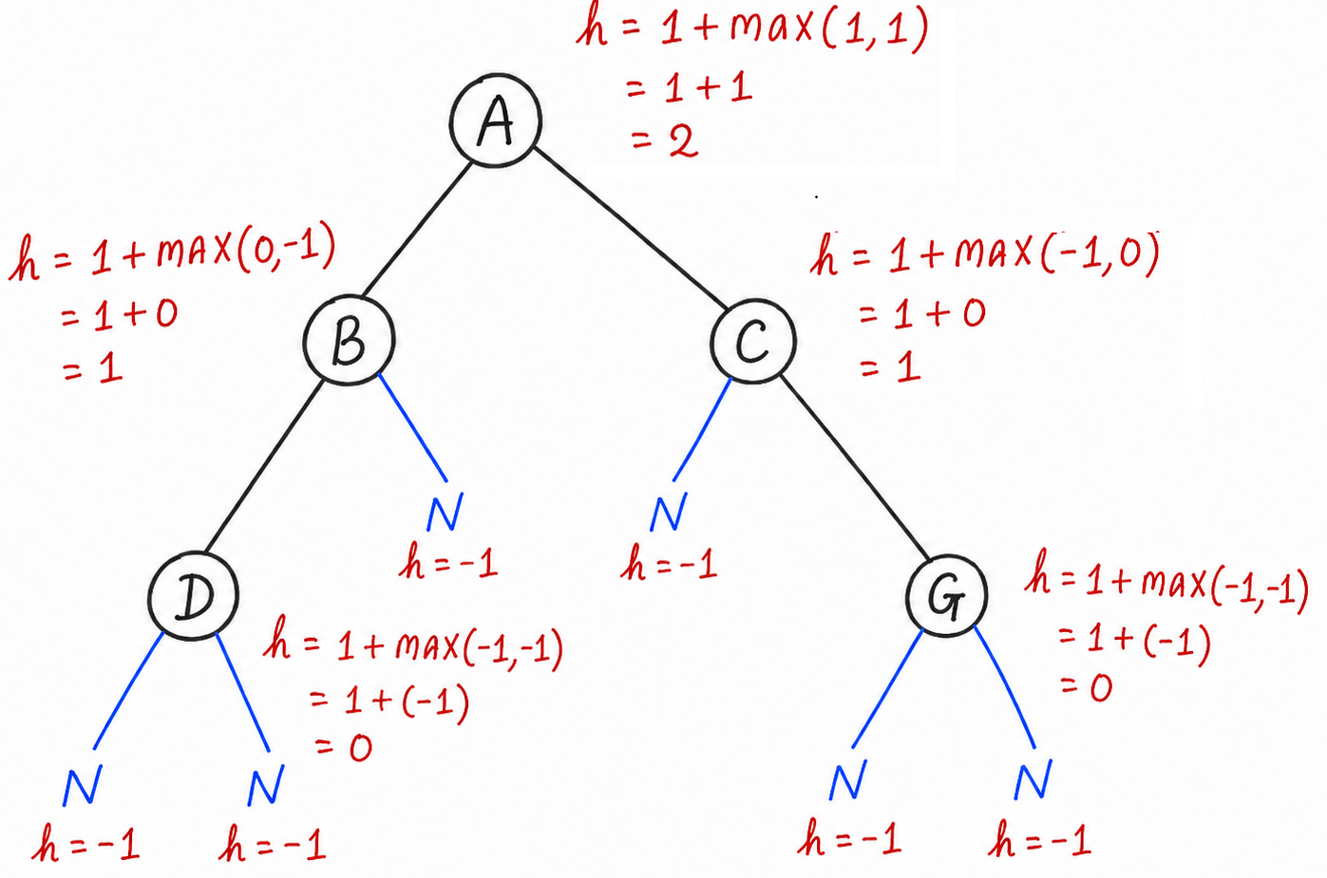
Get Height of a Node
Height = length of the longest path from a node to one of its leaf nodes.
Empty subtree height is -1, so a leaf node has height 0.
public static int getHeight(TNode node) {
// Base Case: empty tree
if (node == null) return -1;
// Recursive Case:
// Get the heights of the left and right subtrees
int leftHeight = getHeight(node.left);
int rightHeight = getHeight(node.right);
// Compute the height of the current subtree
return 1 + Math.max(leftHeight,rightHeight);
}
// Example:
// Height of A = 2
// Height of B, C = 1
// Height of leaf (D, G) = 0
CSE220 | Binary Tree

Slide 16
Get Height of a Node
CSE220 | Binary Tree

Slide 17
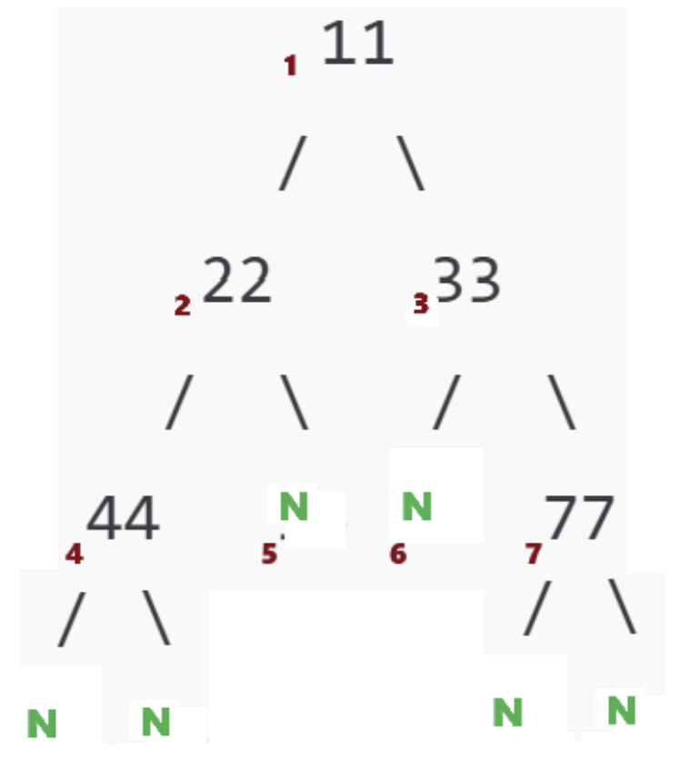
Get Size of a Binary Tree
Size = total number of actual nodes in the tree.
Null links are not counted as nodes.
public static int getSize(TNode node) {
// Base case
if (node == null) return 0;
// Recursive case:
The size is the current node (1)
+ size of left subtree + size of right subtree
return 1 + getSize(node.left) + getSize(node.right);
}
// Output: Size of the tree: 5
CSE220 | Binary Tree

Slide 18
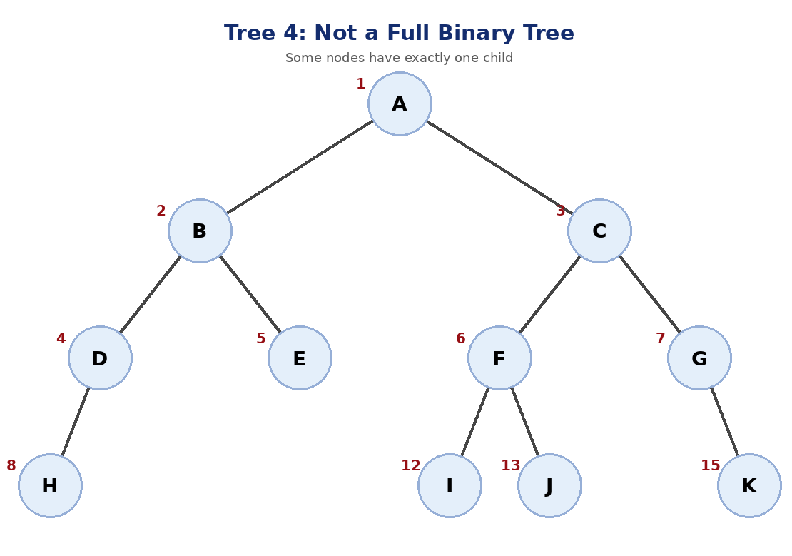
Practice problem: Full Binary Tree Check
Rule of a full binary tree
Every node has either exactly 0 children or exactly 2 children.
// Returns true if the tree is a full binary tree
public static boolean isFullTree(TNode root) {
// Empty tree is full
if (root == null) {
return true;
}
// Leaf node is valid
if (root.left == null && root.right == null) {
return true;
}
// Node with two children: both subtrees must also be full
if (root.left != null && root.right != null) {
return isFullTree(root.left) && isFullTree(root.right);
}
// Node with only one child: not full
return false;
}
Expected result
The tree is NOT a full binary tree.
CSE220 | Binary Tree

Slide 19
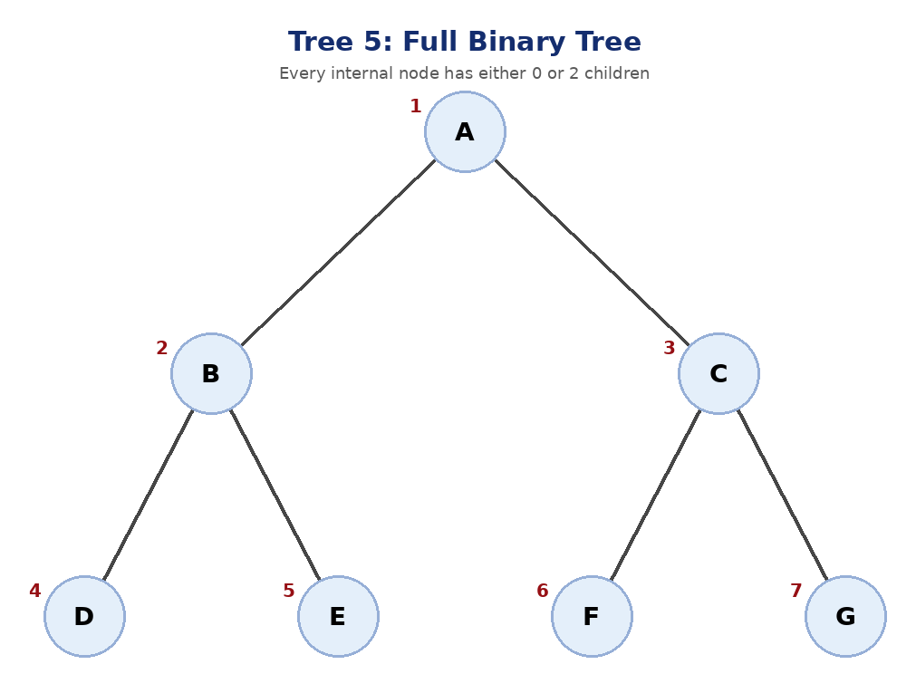
Practice problem: Full Binary Tree Check
Rule of a full binary tree
Every node has either exactly 0 children or exactly 2 children.
// Returns true if the tree is a full binary tree
public static boolean isFullTree(TNode root) {
// Empty tree is full
if (root == null) {
return true;
}
// Leaf node is valid
if (root.left == null && root.right == null) {
return true;
}
// Node with two children: both subtrees must also be full
if (root.left != null && root.right != null) {
return isFullTree(root.left) && isFullTree(root.right);
}
// Node with only one child: not full
return false;
}
Expected result
The tree is a full binary tree.
CSE220 | Binary Tree

Slide 20
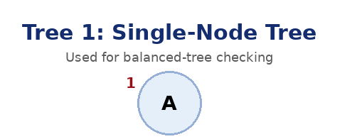
Practice problem: Check whether the tree is Balanced
// Calculates the height difference between left and right subtrees
public static int getDf(TNode node) {
// Base case: if node is null, return -1
if (node == null) {
return -1;
}
// Get the height of left and right subtrees
int leftHeight = getHeight(node.left);
int rightHeight = getHeight(node.right);
// Return the absolute difference
return Math.abs(leftHeight - rightHeight);
}
// Returns true if the tree is height-balanced
public static boolean isBalanced(TNode root) {
if (root == null) return true;
int df = getDf(root);
if (df > 1) {
return false;
}
return isBalanced(root.left) && isBalanced(root.right);
}
Balanced / Height-balanced Binary Tree:
The height of the left and right subtree of any node differ by not more than 1.
df = | height(left) - height(right) |
Acceptable values of df = 0, 1
If df>1, then not balanced
Expected result
The tree is balanced.
CSE220 | Binary Tree

Slide 21
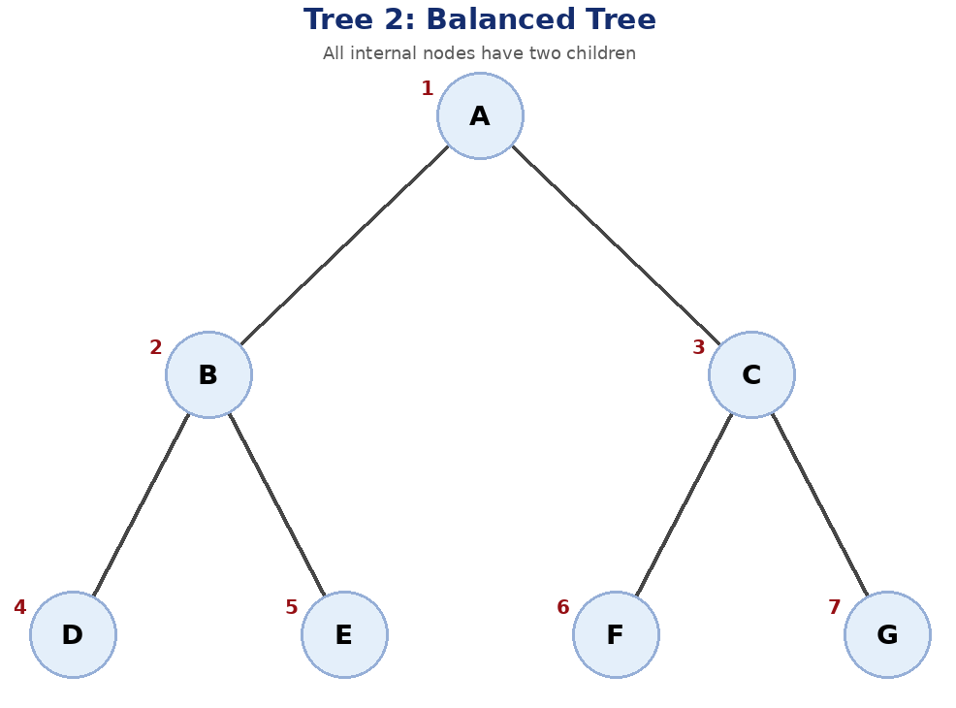
Practice problem: Check whether the tree is Balanced
// Calculates the height difference between left and right subtrees
public static int getDf(TNode node) {
// Base case: if node is null, return -1
if (node == null) {
return -1;
}
// Get the height of left and right subtrees
int leftHeight = getHeight(node.left);
int rightHeight = getHeight(node.right);
// Return the absolute difference
return Math.abs(leftHeight - rightHeight);
}
// Returns true if the tree is height-balanced
public static boolean isBalanced(TNode root) {
if (root == null) return true;
int df = getDf(root);
if (df > 1) {
return false;
}
return isBalanced(root.left) && isBalanced(root.right);
}
Expected result
The tree is balanced.
CSE220 | Binary Tree

Slide 22
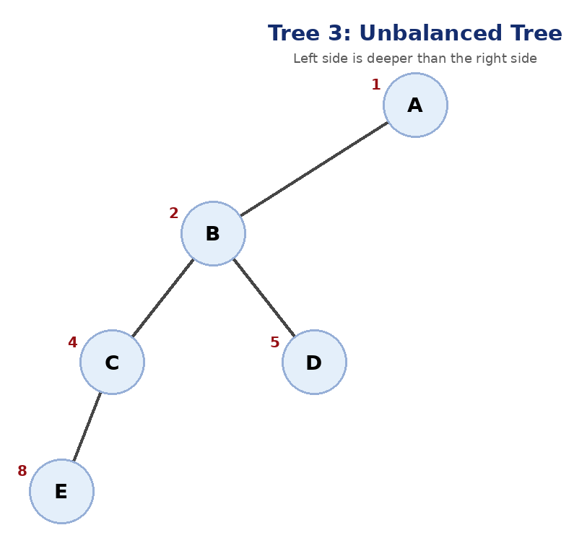
Practice problem: Check whether the tree is Balanced
// Calculates the height difference between left and right subtrees
public static int getDf(TNode node) {
// Base case: if node is null, return -1
if (node == null) {
return -1;
}
// Get the height of left and right subtrees
int leftHeight = getHeight(node.left);
int rightHeight = getHeight(node.right);
// Return the absolute difference
return Math.abs(leftHeight - rightHeight);
}
// Returns true if the tree is height-balanced
public static boolean isBalanced(TNode root) {
if (root == null) return true;
int df = getDf(root);
if (df > 1) {
return false;
}
return isBalanced(root.left) && isBalanced(root.right);
}
Expected result
The tree is not balanced.
(At node A, the height difference becomes greater than 1.)
CSE220 | Binary Tree

Slide 23
Recordings:
https://www.youtube.com/playlist?list=PLMGLE8uIDUqo

Slide 24
The End

